Slide 1

Coursera Data Science Capstone Project Location recommendation to start Indian Restaurant in Toronto city
Mohammed Amjad Ali

Slide 2
i.Introduction/Business Problem Let say if you are a business manager who want to invest in Indian restaurant in your resident city. You are live in the mid-size city which has fast growth. You have to decide where or which neighborhoods to open the restaurant. In order to answer this question, you have to build a model get some recommendations where to start your business. Therefore, we will learn a model from a mature city/metropolitan city since we believe that it is more developed and your city will become a metropolis someday. Another thing you believe is that any one of business venue does not exist alone, and "Indian restaurant" always tends to be found with some other type of shops, because neighborhood’s have "cultures" to like them both.

Slide 3
ii. Solution/Methodology
Learn how dose venues around the Indian restaurant in a big city such as Toronto….
Build a model that pride the number of Indian restaurant given the environmental venue information
Predict # of Indian restaurant in target city
Compare with current existing numbers, recommended locations

Slide 4
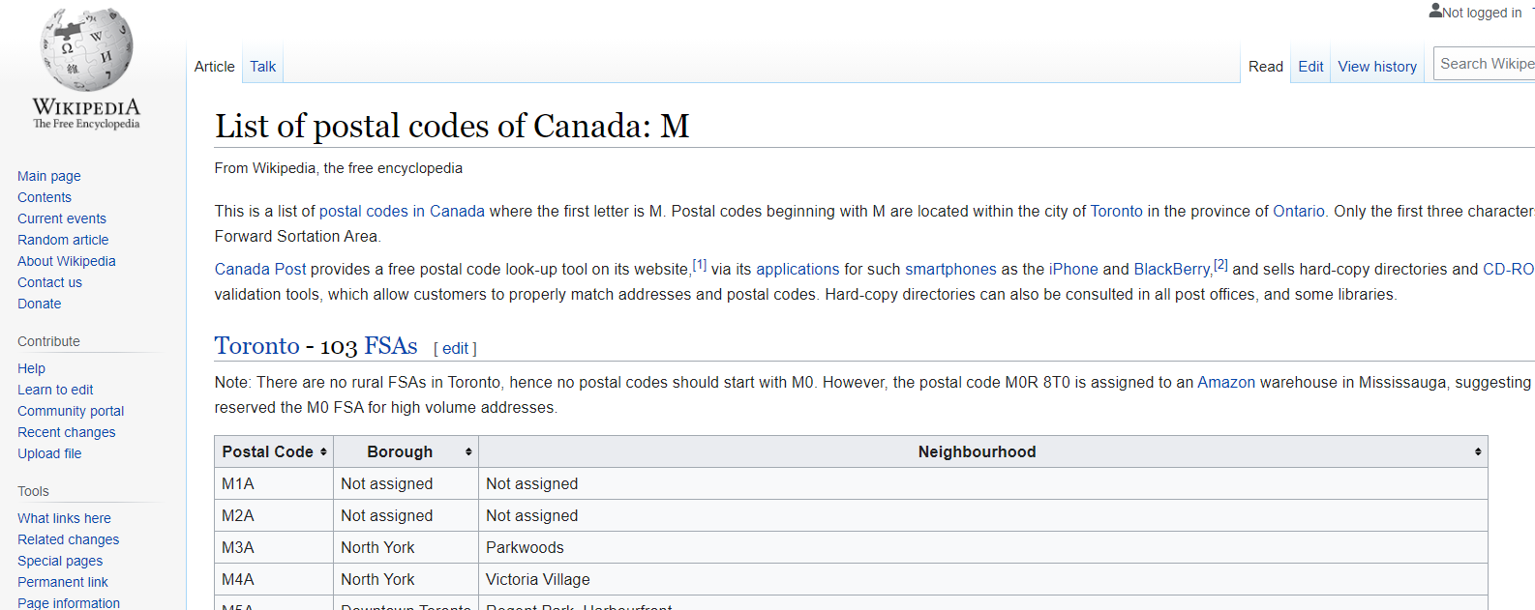
Data Import (Toronto) https://en.wikipedia.org/wiki/List_of_postal_codes_of_Canada:_M
Scrap from website and organize into Data frame

Slide 5
Get location information
Use geocoder package to get location information:
Plot the location using folium package (Neighborhood location in Toronto on map)

Slide 6
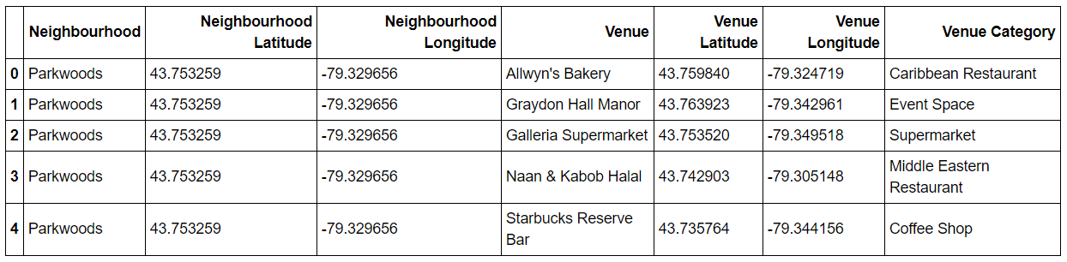
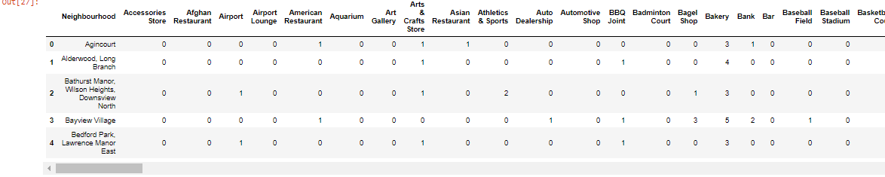
Get venues information
Use Foursquare API, we can explore the venues around on specific location, so we could achieve venues’ name and category
create one-hot encoding for each catogory

Slide 7

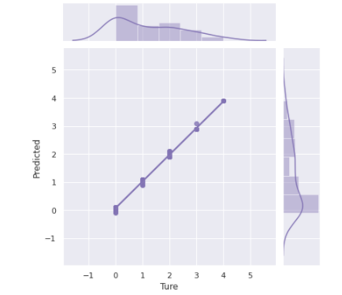
Build Model for prediction
We will use number of venues in each neighborhood except Indian restaurant as inputs
and number of Indian restaurants
Use SVR (rbf kernel ) as learning algorithm output.
Step 1. optimize the hyperparameter using GridSearchCVon parameter ‘gamma’ and ’C’. 5 fold cross validation is used.
Step 2. Train the dataset the plot prediction from the model and True value

Slide 8
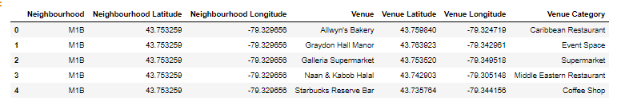
Get information of target city
Get venues information from Toronto.

Slide 9
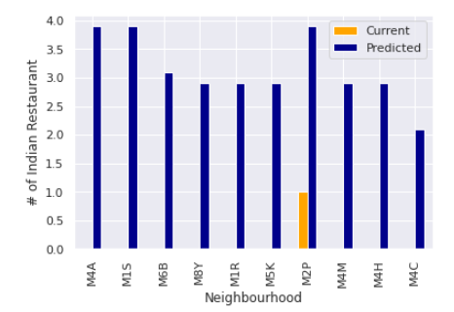
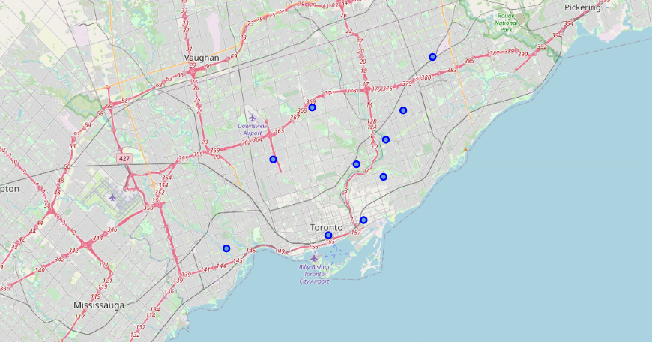
Predict using trained model
Top 10 recommendations locations to start Indian Restaurant in Toronto
Top 10 recommendations locations to start Indian Restaurant in Toronto (Map)

Slide 10
iii.Result and iv.Discussion
Used the Foursquare API get the venues information on given locations
Build predictive models with SVR algorithm
Top 10 recommendations of location to invest "Indian Restaurant" in Toronto
These things can make it better:
1. This model is built on the assumption that the target city will have a trend to grow to
"Big-city" like we used into model training.
2. The training dataset still very small, if we can get more data from more big cities, we
Can make the model better
3. Foursquare app can only give limited venues exploration on free version, it is better to
Conclude all of the venues to avoid bias coming from the sampling

Slide 11
v. Acknowledgement
In this project, we have to acknowledge the data science course provided by IBM powered by Coursera

